Slide 1
9.7 Gradient of a Scalar Field.
Directional Derivative

Slide 2

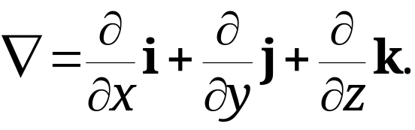
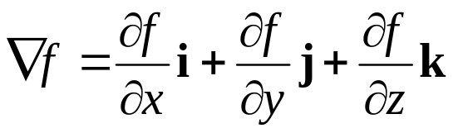
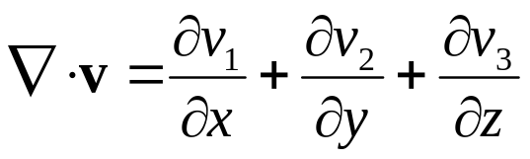
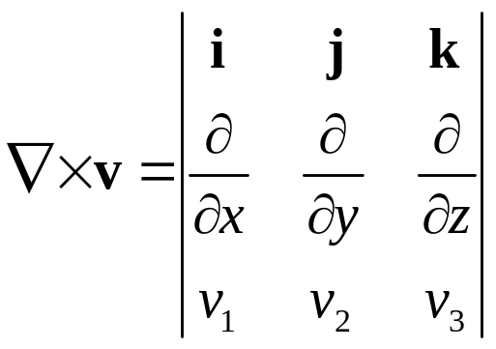
9.7 Gradient of a Scalar Field. Directional Derivative
Introducing differential operator (read nabla) defined by
(1*)
Three types of operation with :
Gradient of the scalar field f (x, y, z):
Divergence of the vector field v:
Curl of the vector field v:
(vector)
(scalar)
(vector)

Slide 3
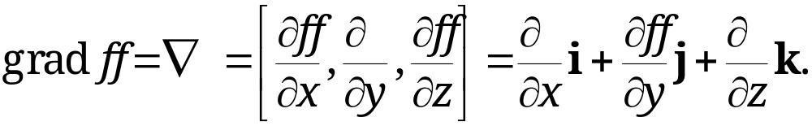
9.7 Gradient of a Scalar Field. Directional Derivative
Gradient
Definition 1
Gradient
Given a scalar function f(x, y, z) defined and differentiable in a domain in 3-space with Cartesian coordinates x, y, z.
Then, the gradient of f(x, y, z) is defined as the vector function
(1)
Section 9.7 p<number>

Slide 4
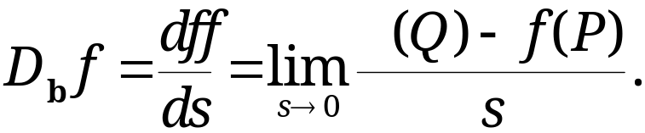

9.7 Gradient of a Scalar Field. Directional Derivative
Directional Derivative
Definition 2
Directional Derivative
The directional derivative D_{b}f or df/ds of a function f(x, y, z) at a point P in the direction of a unit vector b is defined as:
(2)
Q is a point on the straight line in the direction of b from P
s is the distance from P to Q.
R² illustration: is the
slope at P along b direction
f(x, y)
f(Q)
f(P)
b
Q
P
s
Section 9.7 p<number>

Slide 5
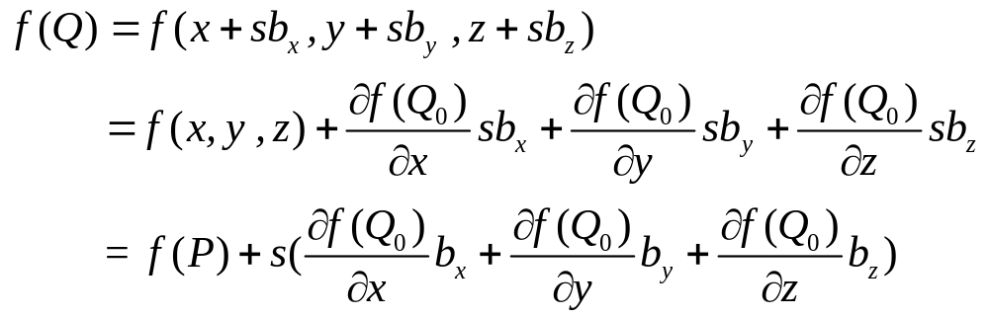
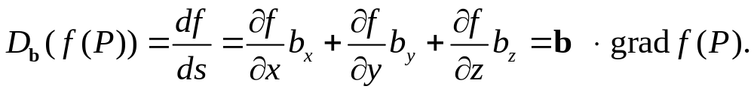
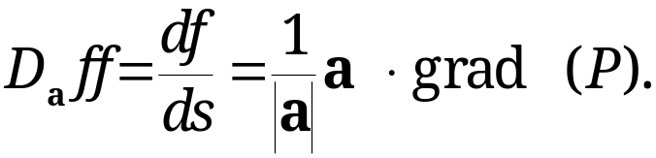
9.7 Gradient of a Scalar Field. Directional Derivative
With P: (x, y, z), b=[b_{x}, b_{y ,} b_{z} ], we have Q: (x+sb_{x}, y+sb_{y ,} z+sb_{z} ).
Then, by the mean value theorem:
where Q₀ is a point lying in the line segment [P, Q]. Hence,
ATTENTION! If the direction is given by a non-zero vector a, then
Section 9.7 p<number>

Slide 6
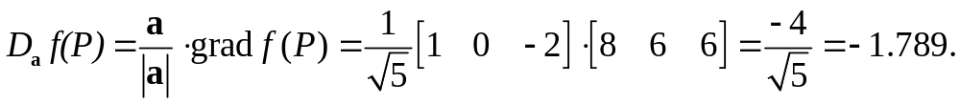
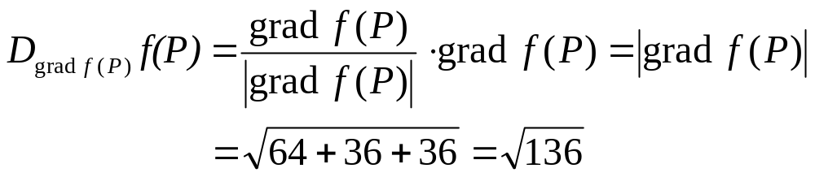
9.7 Gradient of a Scalar Field. Directional Derivative
EXAMPLE 1
Find the directional derivative of f(x, y, z) = 2x² + 3y² +z² at P: (2, 1, 3) in the direction of a= [1, 0, −2].
Solution:
grad f = [4x, 6y, 2z] at point P: (2, 1, 3) → grad f(P) = [8, 6, 6].
Then directional derivative at P in direction of a:
How about directional derivative at P in direction of grad f ?
(Maximum derivative
among all directions)
Section 9.7 p<number>

Slide 7
9.7 Gradient of a Scalar Field. Directional Derivative
Gradient Is a Vector. Maximum Increase
Theorem 1
Use of Gradient: Direction of Maximum Increase
With P:(x,y,z) and f(P) = f(x, y, z) a scalar function having continuous first partial derivatives in some domain B in space. Then the vector grad f exists in B and has the following two important properties:
grad f(P) is a vector, i.e., its length and direction are independent of the particular choice of Cartesian coordinates.
grad f(P), if non-zero, gives the direction of maximum increase of f(x, y, z) at P.
Section 9.7 p<number>

Slide 8
9.7 Gradient of a Scalar Field. Directional Derivative
Proof of Theorem 1
Since f(P) is a scaler function and the distance between any two points is independent of the choice of Cartesian coordinate system, directional derivative also satisfies this property.
For any unit vector b, we have
D_{b}(f(P))=b ∙ grad f(P)=|grad f(P)| cosγ,
where γ is the angle between the vector b and grad f(P).
D_{b}(f(P)) is maximized when cosγ=1, γ=0, and then D_{b}(f(P)) =|grad f(P)|. It follows that the length and the direction of grad f(P) are independent of the choice of coordinates.
Since γ=0 if and only if b has the direction of grad f(P). Then, Property 2 is proved.
Section 9.7 p<number>

Slide 9
9.7 Gradient of a Scalar Field. Directional Derivative
Gradient as Surface Normal Vector
Let S be a surface represented by f(x, y, z)=c=constant, where f is differentiable. Such a surface is called a level surface of f.
Let C be a curve on S through a point P of S. It can be represented by r(t)=[x(t), y(t), z(t)]. Since C lies on S, we have
f(x(t), y(t), z(t))=c.
Tangent vector of C is r’(t). The tangent vectors of all curves on S passing through P generally form a plane, which is called the tangent plane of S at P.
The straight line through point P perpendicular to the tangent plane is called the surface normal to S of P.
A vector in the direction of the surface normal is called surface normal vector of S at P.
Section 9.7 p<number>

Slide 10
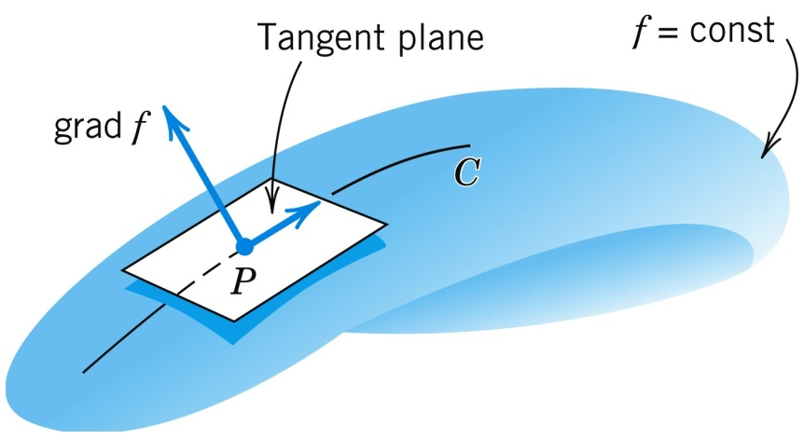
9.7 Gradient of a Scalar Field. Directional Derivative
Gradient as Surface Normal Vector
Theorem 2
Gradient as Surface Normal Vector
Let f be a differentiable scalar function in space. Let f(x, y, z) = c = const. represent a level surface S. Then, if the grad f (P) of S is a non-zero vector, it is a normal vector of S at P.
Fig. 216. Gradient as surface normal vector
Section 9.7 p<number>

Slide 11

9.7 Gradient of a Scalar Field. Directional Derivative
Proof of Theorem 2
By the definition of surface normal vector, we need to prove that grad f(P) is perpendicular to the tangent plane of S at P.
Since the tangent plane of S at P is formed by tangent vectors of all curves on S passing through P, it suffices to prove grad f(P) is perpendicular to all tangent vectors of all curves on S passing through P.
Note that a tangent vector of C is r’(t)=[x’(t), y’(t), z’(t)]. Since f(x(t), y(t), z(t))=c, by differentiating it on t, we have
Now select the parameter t which corresponds to point P (note that different curves may have different t’s, which correspond to the same point P). Then, the desired result follows.
Section 9.7 p<number>

Slide 12
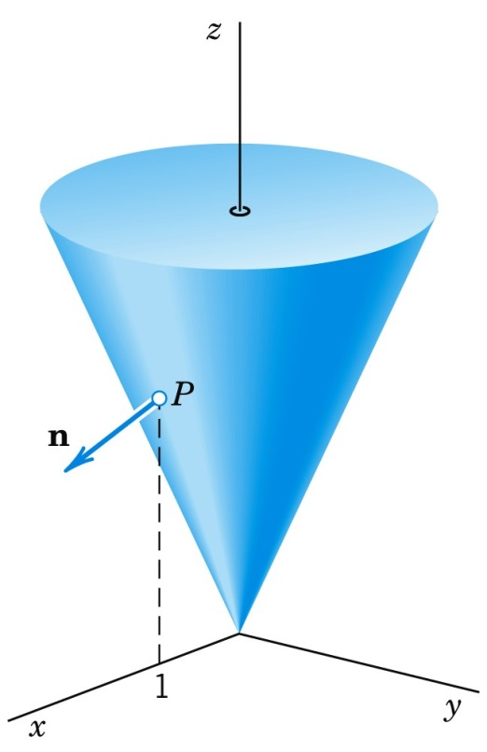
9.7 Gradient of a Scalar Field. Directional Derivative
EXAMPLE 2 Gradient as Surface Normal Vector. Cone
Find a unit normal vector n of the cone of revolution
z² = 4(x² + y²) at the point P: (1, 0, 2).
Cone and unit normal vector n
Section 9.7 p<number>

Slide 13
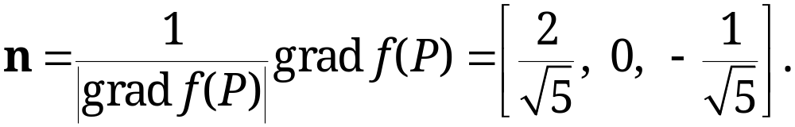
9.7 Gradient of a Scalar Field. Directional Derivative
EXAMPLE 2 Gradient as Surface Normal Vector. Cone
Solution:
The cone is the level surface f = 0 of f(x, y, z) = 4(x² + y²) − z². Thus,
grad f = [8x, 8y, −2z], grad f(P) = [8, 0, -4]
Vector n points downward as it has a negative z-component. The other unit normal vector of the cone at P is −n.
Section 9.7 p<number>

Slide 14
9.7 Gradient of a Scalar Field. Directional Derivative
Vector Fields That Are Gradients of Scalar Fields (“Potentials”)
Potential Function: If a vector function (or field) v(P) can be expressed as the gradient of a scalar function, i.e.,
v(P) = grad f(P)
Then f(P) is called a potential function or potential of v(P).
A vector field v(P) obtained from a potential function is called conservative, because energy is conserved in such a field. We will show this later in Sec. 10.2.
Conservative vector fields play a central role in physics and engineering.
Section 9.7 p<number>

Slide 15
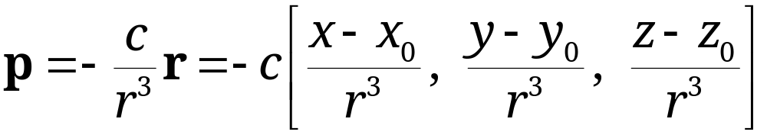

9.7 Gradient of a Scalar Field. Directional Derivative
Theorem 3
Gravitational Field. Laplace’s Equation
The gravitational field from Example 3 of Section 9.4
between two particles at points P₀: (x₀, y₀, z₀) and P: (x, y, z)
(r > 0 is the distance between P₀ and P) is a vector field.
p can be derived as ,
with f(x, y, z) = c/r .
f(x, y, z) = c/r is the potential function of p.
Section 9.7 p<number>

Slide 16
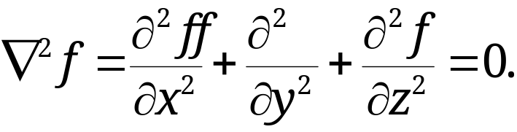

9.7 Gradient of a Scalar Field. Directional Derivative
Theorem 3 (continued)
Gravitational Field. Laplace’s Equation
Thus, p = grad f = grad (c/r). This potential f is a solution of Laplace’s equation
[ (read nabla squared f ) is called the Laplacian of f]
Section 9.7 p<number>

Slide 17
9.8 Divergence of a Vector Field

Slide 18
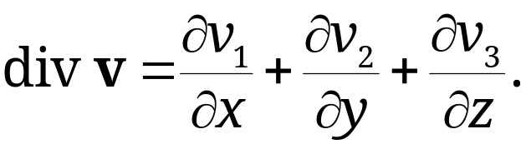
9.8 Divergence of a Vector Field
Let v(x, y, z) be a differentiable vector function, where x, y, z are Cartesian coordinates, and let v=[v₁, v₂, v₃]. Then, the function
(1)
is called the divergence of v or the divergence of the vector field defined by v.
Exercise: Suppose v = [3xz, 2xy, −yz²]. Find div v.
Solution: div v = 3z + 2x − 2yz.
Section 9.8 p<number>

Slide 19
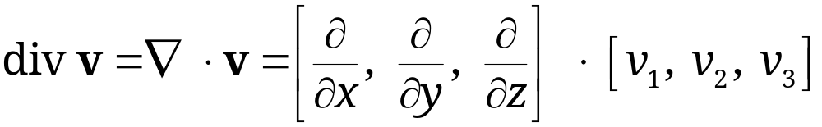
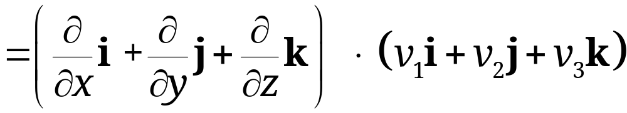
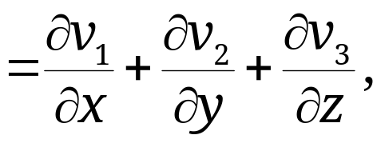
9.8 Divergence of a Vector Field
Another common notation for the divergence is to use the dot product:
with the understanding that the “product” (∂/∂x )v₁ in the dot product means the partial derivative ∂v₁/∂x, etc.
Section 9.8 p<number>

Slide 20
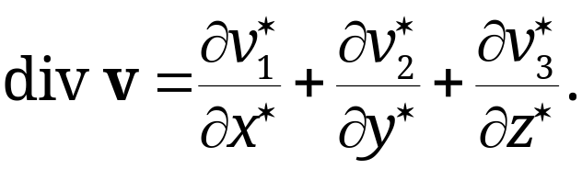
9.8 Divergence of a Vector Field
Theorem 1
Invariance of the Divergence
The divergence div v is a scalar function, that is, its values depend only on the points in space (and, of course, on v) but not on the choice of the coordinates in (1), so that with respect to other Cartesian coordinates x*, y*, z* and the corresponding components v₁*, v₂*, v₃* of v,
(2)
Note: this theorem will be proved in Section 10.7 using integrals
Section 9.8 p<number>

Slide 21
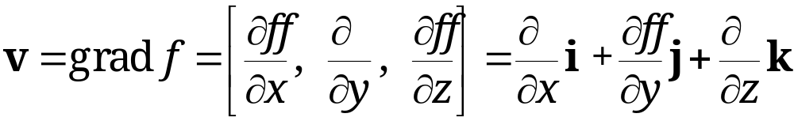
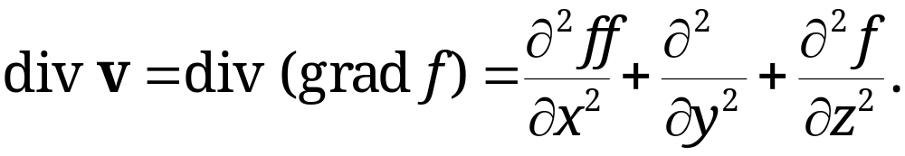

9.8 Divergence of a Vector Field
The Laplacian
Let f (x, y, z) be a twice differentiable scalar function. Its gradient is
Obtain the divergence of v,
Hence, we have the basic result that the divergence of the gradient is the Laplacian,
(3)
(read nabla squared f ) is called the Laplacian of f.
Section 9.8 p<number>

Slide 22


9.7 Gradient of a Scalar Field. Directional Derivative
Laplace’s equation of the form is an important partial differential equation in physics and applications.
Example: the potential function of the gravitational field p, f(x, y, z) = c/r , satisfies the Laplace equation
Section 9.7 p<number>

Slide 23
9.9 Curl of a Vector Field

Slide 24
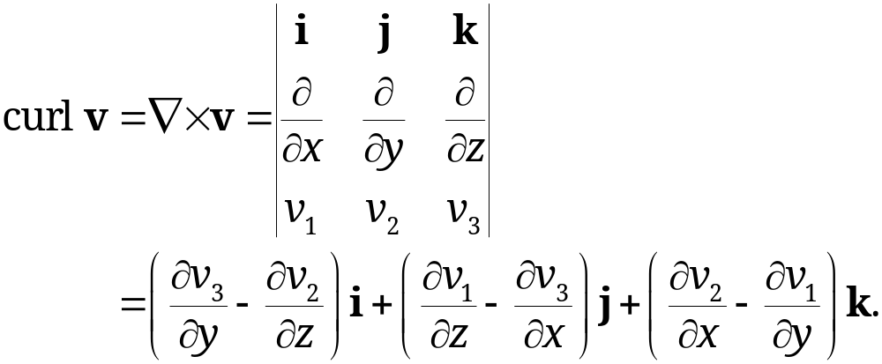
9.9 Curl of a Vector Field
Let v(x, y, z) = [v₁, v₂, v₃] = v₁i + v₂ j + v₃k be a differentiable vector function of x, y, z.
The curl of v is defined by the “symbolic” determinant
(1)
Note that x, y, z are right-handed here; if the coordinates are left-handed, then curl v= (-1) × the determinant
One may also use the notation rot v instead of curl v.
(curl v is a vector
function of x, y, z!)
Section 9.9 p<number>

Slide 25
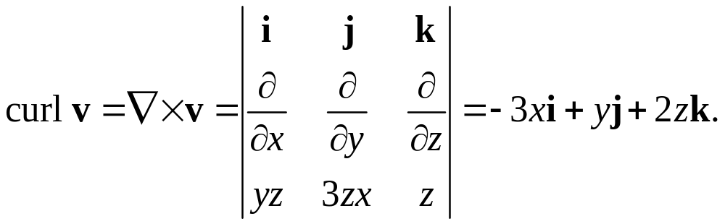
9.9 Curl of a Vector Field
EXAMPLE 1
Curl of a Vector Function
Let v = [yz, 3zx, z] = yzi+3zxj+zk with right-handed x, y, z. Find curl v.
Solution:
Section 9.9 p<number>

Slide 26
9.9 Curl of a Vector Field
EXAMPLE 2
Rotation of a Rigid Body. Relation to the Curl
From Example 5, Sec. 9.3, rotation of a rigid body B about a fixed axis in space can be described by a vector w of magnitude ω in the direction of the axis of rotation.
Velocity field of the rotation is
given by:
v = w × r
r is position vector of a moving point with respect to a Cartesian coordinate system having the origin on the axis of rotation.
ω
Velocity
vector v
Rigid
body B
Position vector r
Section 9.9 p<number>

Slide 27
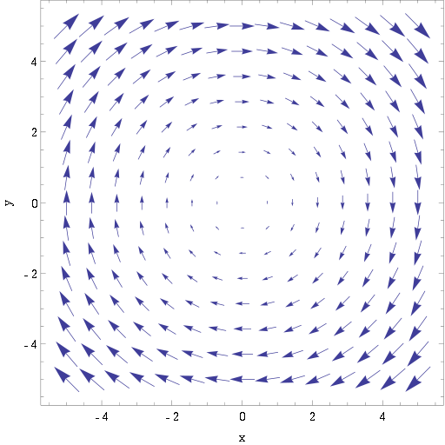
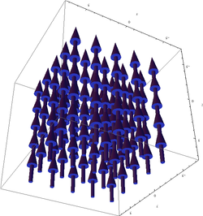
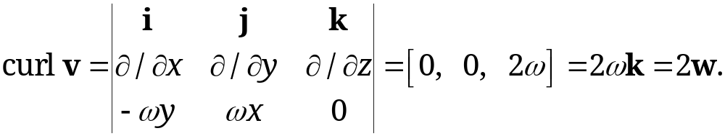
9.9 Curl of a Vector Field
Using right-handed Cartesian coordinates with axis of rotation in z-axis:
w = [0, 0, ω] = ωk,
v = w × r = [−ωy, ωx, 0] = −ωyi + ωxj.
Then,
y
z
v
curl v
x
x
y
Section 9.9 p<number>

Slide 28
9.9 Curl of a Vector Field
Theorem 1
Rotating Body and Curl
The curl of the velocity field of a rotating rigid body has the direction of the axis of the rotation, and its magnitude equals twice the angular speed of the rotation.
Important Note
curl v (a vector function of (x, y, z)) actually yields information about the rotation (both the direction of the axis and magnitude) at the location (x, y, z). It just so happened that for the rigid body above rotation is the same at all points.
Section 9.9 p<number>

Slide 29

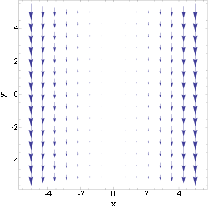
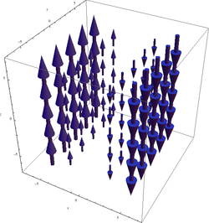
9.9 Curl of a Vector Field
EXAMPLE 3 (source: http://en.wikipedia.org/wiki/Curl_(mathematics))
Given: v = −x²j
Rotation is not obvious from v. But note that v is larger as x is further to the right. A small particle at x=4, say, will experience larger “velocity” from the right side than the left, inducing a clockwise rotation. The same particle at x=-4 will have anticlockwise rotation.
yields the angular rotation at (x,y,z) location
y
z
v
curl v
x
x
y
Section 9.9 p<number>

Slide 30
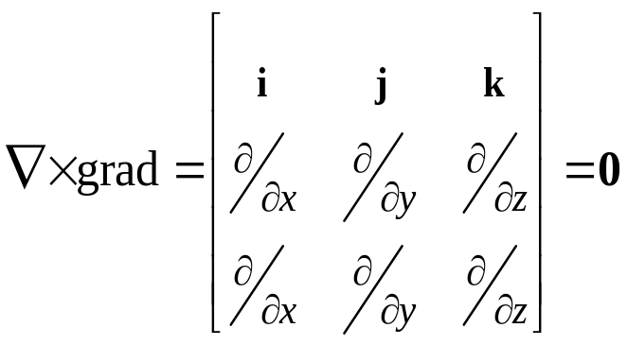
Theorem 2
9.9 Curl of a Vector Field
Grad, Div, Curl
A vector field is called irrotational if curl v = 0. For example: v=[5, 0, 0].
Gradient fields are all irrotational. Given a vector field v having a potential function f, i.e., v=grad f. Then
(2) curl v = curl (grad f ) = 0.
This is due to the fact that
Furthermore, the divergence of the curl of a twice continuously differentiable vector function v is zero,
(3) div (curl v) = 0.
Section 9.9 p<number>

Slide 31
9.9 Curl of a Vector Field
Theorem 3
Invariance of the Curl
curl v is a vector. It has a length and a direction that are independent of the particular choice of a Cartesian coordinate system in space.
Note: the proof of this theorem is quite involved and has three pages. Please see pages A73-A75 in the textbook for details.
Section 9.9 p<number>

Slide 32
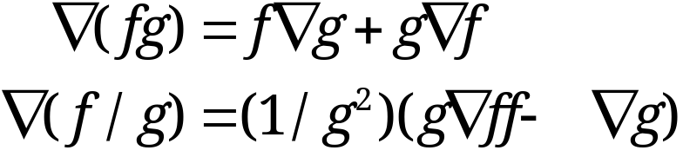


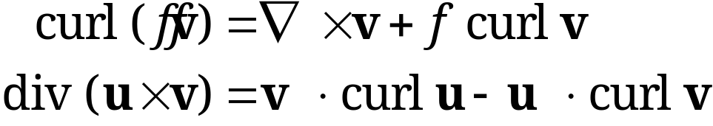
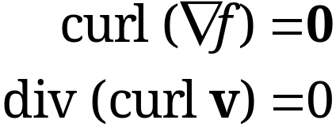
9.9 Curl of a Vector Field
Some Basic Formulas for grad, div, curl
Gradient
Divergence and gradient
Curl, divergence, and gradient
Section 9.9 p<number>

Slide 33
9.8 Divergence of a Vector Field
EXAMPLE 2 Flow of a Compressible Fluid.
Physical Meaning of the Divergence (Self-study)
Consider the motion of a fluid in a region R having no sources or sinks, i.e., no points in R at which fluid is produced or disappears.
Fluid here includes gases and vapors, which have high compressibility. Their density ρ (= mass per unit volume) depends on the coordinates x, y, z in space and may also depend on time t.
Let v(x,y,z)= [v₁, v₂, v₃] = v₁i + v₂j + v₃k be the velocity vector of the fluid motion. We also define
(4) u(x,y,z)= ρv = [u₁, u₂, u₃] = u₁i + u₂j + u₃k,
which is interpreted as rate of mass flow per unit area (or flux).
Section 9.8 p<number>

Slide 34
9.8 Divergence of a Vector Field
Assume v, hence, u, is continuously differentiable vector functions of x, y, z, and t, i.e., they have first partial derivatives which are continuous.
Consider the flow through a rectangular box B of small edges Δx, Δy, Δz parallel to the coordinate axes as shown in Fig. 218.
The box B has the volume ΔV = ΔxΔyΔz.
We are to approximate the change of the mass inside box B by considering the flux across the boundary, that is, the total loss of mass leaving B per unit time.
Section 9.8 p<number>

Slide 35
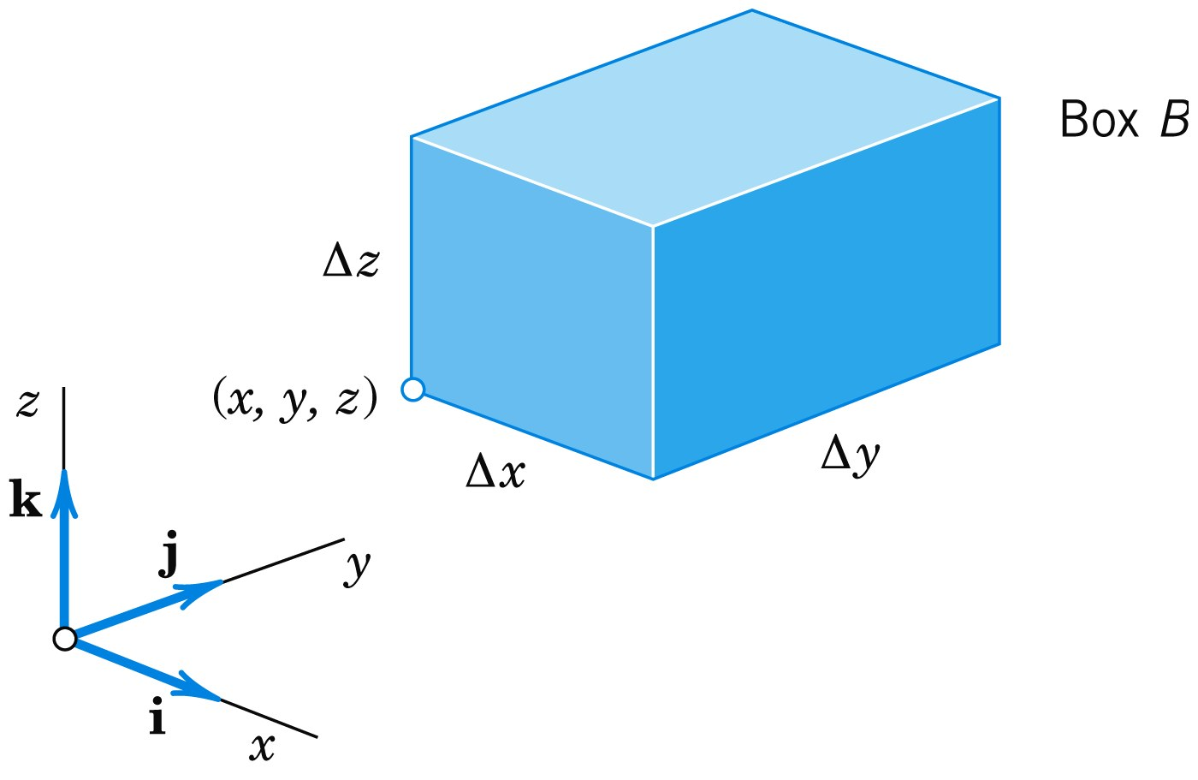
9.8 Divergence of a Vector Field
Fig. 218. Physical interpretation of the divergence
Velocity vector
v₃
v₂
v₁
Face A’
Mass of fluid leaving
during time Δt
(ρv₂)_{y + Δy} Δx Δz Δt
Face A
Area = ΔxΔz
v₁i and v₃k parallel to Face A
Only v₂j causes mass flow through Face A
Mass of fluid entering during time Δt
(ρv₂)_{y} Δx Δz Δt
Subscript indicating the
y-coordinate of the face
Section 9.8 p<number>

Slide 36
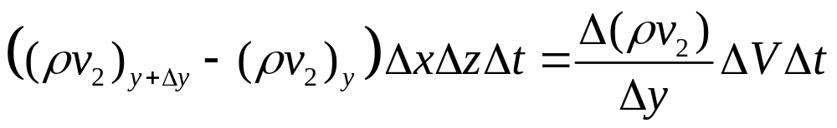
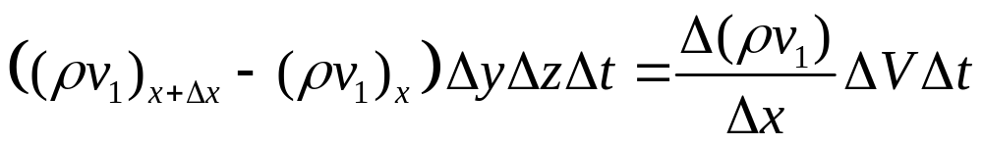

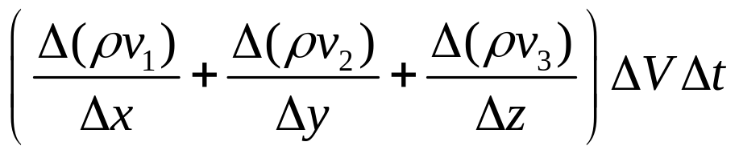
9.8 Divergence of a Vector Field
The net loss of mass due to Face A and A’ of Box B :
Similar expressions obtained by considering the other two pairs of parallel faces of box B.
Together, the total loss of mass in B during time interval Δt is approximately
Section 9.8 p<number>

Slide 37
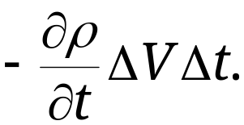
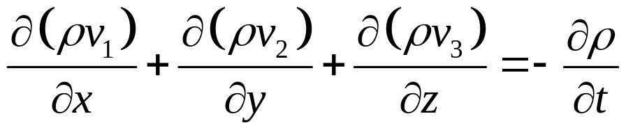
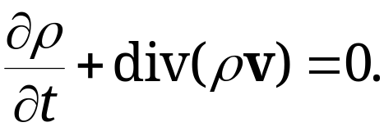
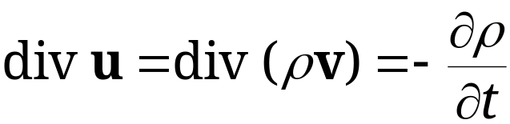
9.8 Divergence of a Vector Field
The outflow of mass must lead to time rate of change of fluid density within box B
Hence, equating both expressions and letting Δx, Δy, Δz, and Δt approach zero, we have
or
(5)
Or, in terms of u, .
(condition for the conservation of mass or the continuity equation of a compressible fluid flow)
Section 9.8 p<number>

Slide 38
9.8 Divergence of a Vector Field
For steady flow, i.e., ρ is time-independent, ∂ρ/∂t = 0, the continuity equation is
(6) div (ρv) = 0.
Incompressible fluid, i.e., ρ is constant, then we have
(7) div v = 0.
This is the condition of incompressibility – the balance of outflow and inflow for a given volume element is zero at any time.
Roughly speaking, the divergence measures outflow minus inflow.
Note again we have assumed that the flow has no sources or sinks, which is essential for our results.
The divergence theorem of Gauss, an integral theorem involving the divergence, will be discussed in Section 10.7.
Section 9.8 p<number>

